Slide 1
Algorithmic Bias in Healthcare: Bias Mitigation in Organ Transplant via Predictive Modeling
Kai Zhang, Ph.D.
UTHealth, SBMI
7/5/2024

Slide 2

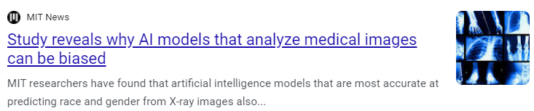

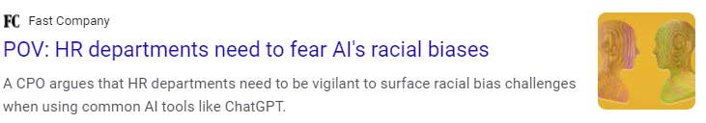


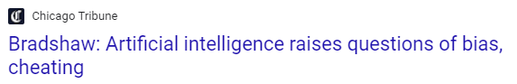
Algorithmic Bias in the Headlines
Notes:
A lecture in success 191 where we're going to learn about algorithmic bias and fairness. Recently, this topic is emerging as a truly pervasive issue in modern Deep Learning and AI more generally, and it's something that can occur at all stages of the AI pipeline, from data collection all the way to model interpretation. In this lecture, we'll not only learn about what algorithmic bias is and how it may arise, but we will also explore some new and exciting methodological advances where we can start to think about how we can build machines capable of identifying and to some degree, actually mitigating these biases. The concept of algorithmic bias points to this observation that neural networks and AI systems, more broadly, are susceptible to significant biases, such that these biases can lead to very real and detrimental societal consequences indeed. Today, more than ever, we are already seeing this manifesting in society, from everything from facial recognition to medical decision making to voice recognition, and on top of this, algorithmic bias can actually perpetuate existing social and cultural biases, such as racial and gender biases. Now we're coming to appreciate and recognize that algorithmic bias in deep learning is a truly pervasive and severe issue, and from this, we really need strategies on all levels to actually combat this problem

Slide 3
Algorithmic Bias in the Headlines
What exactly does bias mean?
Notes:
. To start first, we have to understand what exactly does algorithmic bias actually mean? So let's consider this image. What do you see in this image? How would you describe it? Well, I.

Slide 4
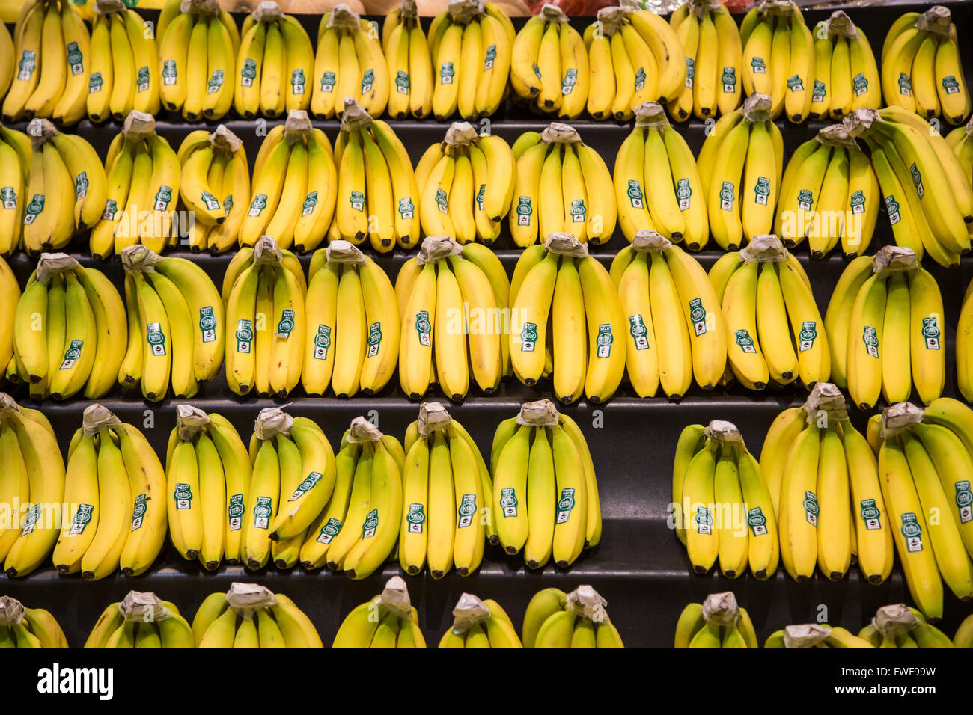
What do you see?

Slide 5
What do you see?
● Bananas
● Stickers
● Bananas at a store
● Bananas on shelves
● Bunches of bananas
● Bananas with stickers on them
● Bunches of bananas with stickers on them on shelves in a store

Slide 6
What do you see?
● Bananas
● Stickers
● Bananas at a store
● Bananas on shelves
● Bunches of bananas
● Bananas with stickers on them
● Bunches of bananas with stickers on them on shelves in a store
...We don’t tend to say
Yellow Bananas

Slide 7
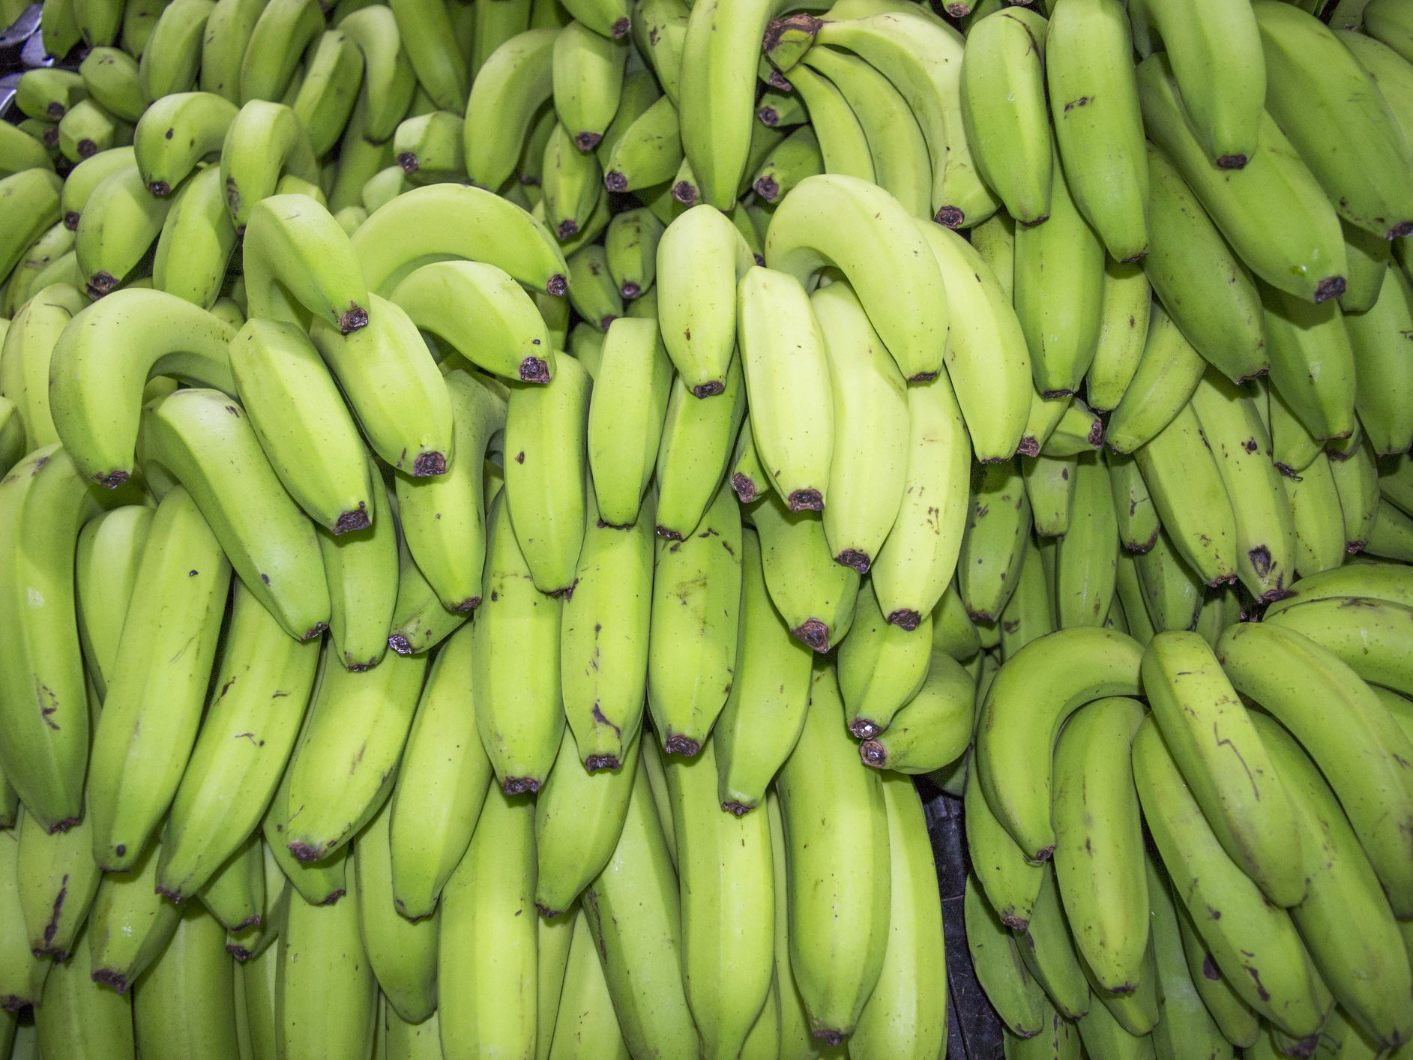
What do you see?

Slide 8
What do you see?
Green Bananas
Unripe Bananas

Slide 9
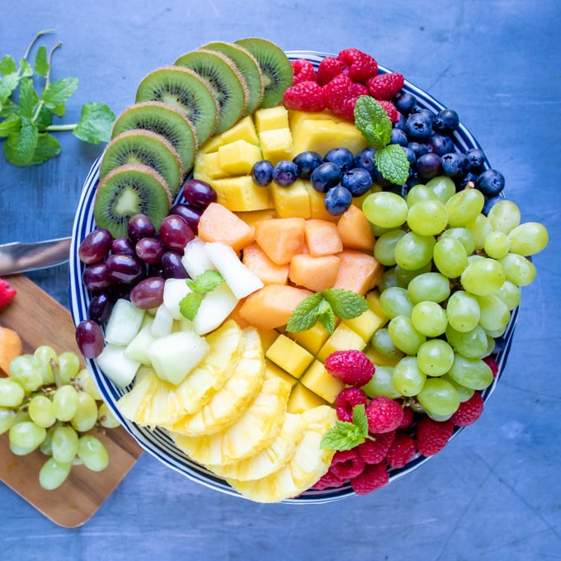
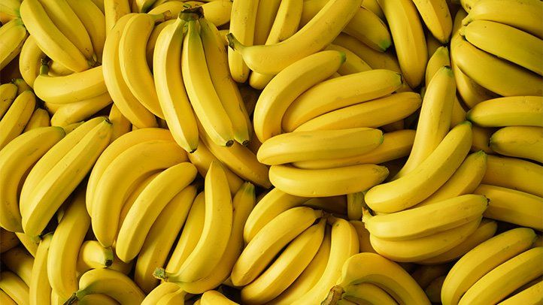
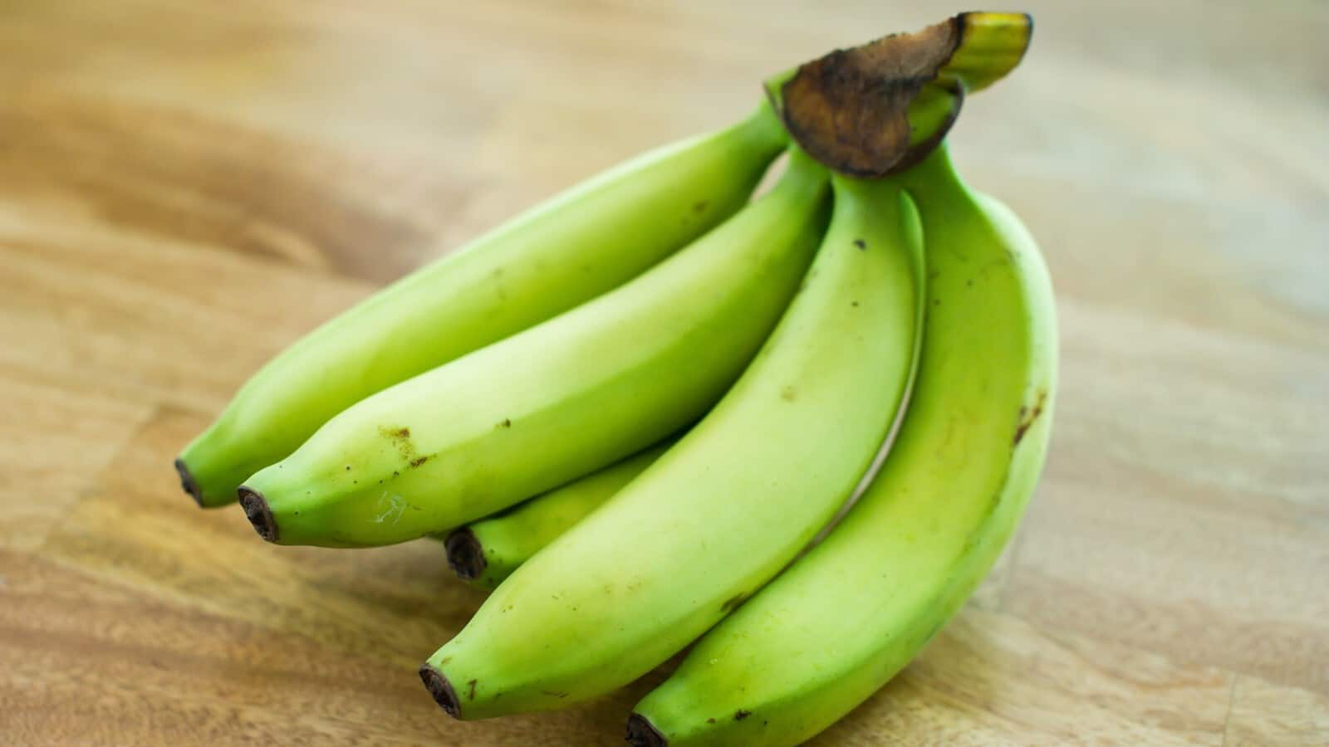
Prototype Theory
There may be some central, prototypical notions of items that arise from stored typical properties for an object category (Rosch, 1975)
Prototypes are “typical” representations of a concept of object
We tend to notice and talk about things that are atypical
Biases and stereotypes arise when particular labels and features confound decisions –whether human or artificial
Fruit
Bananas
“Basic Level”
Unripe Bananas,
Cavendish Bananas
Notes:
Human driven or suggested by an algorithm

Slide 10
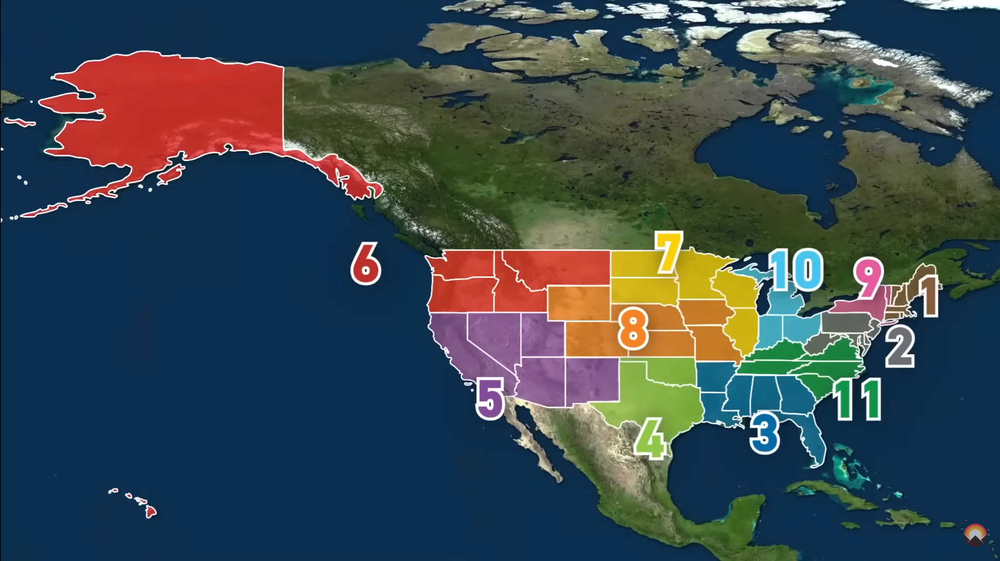
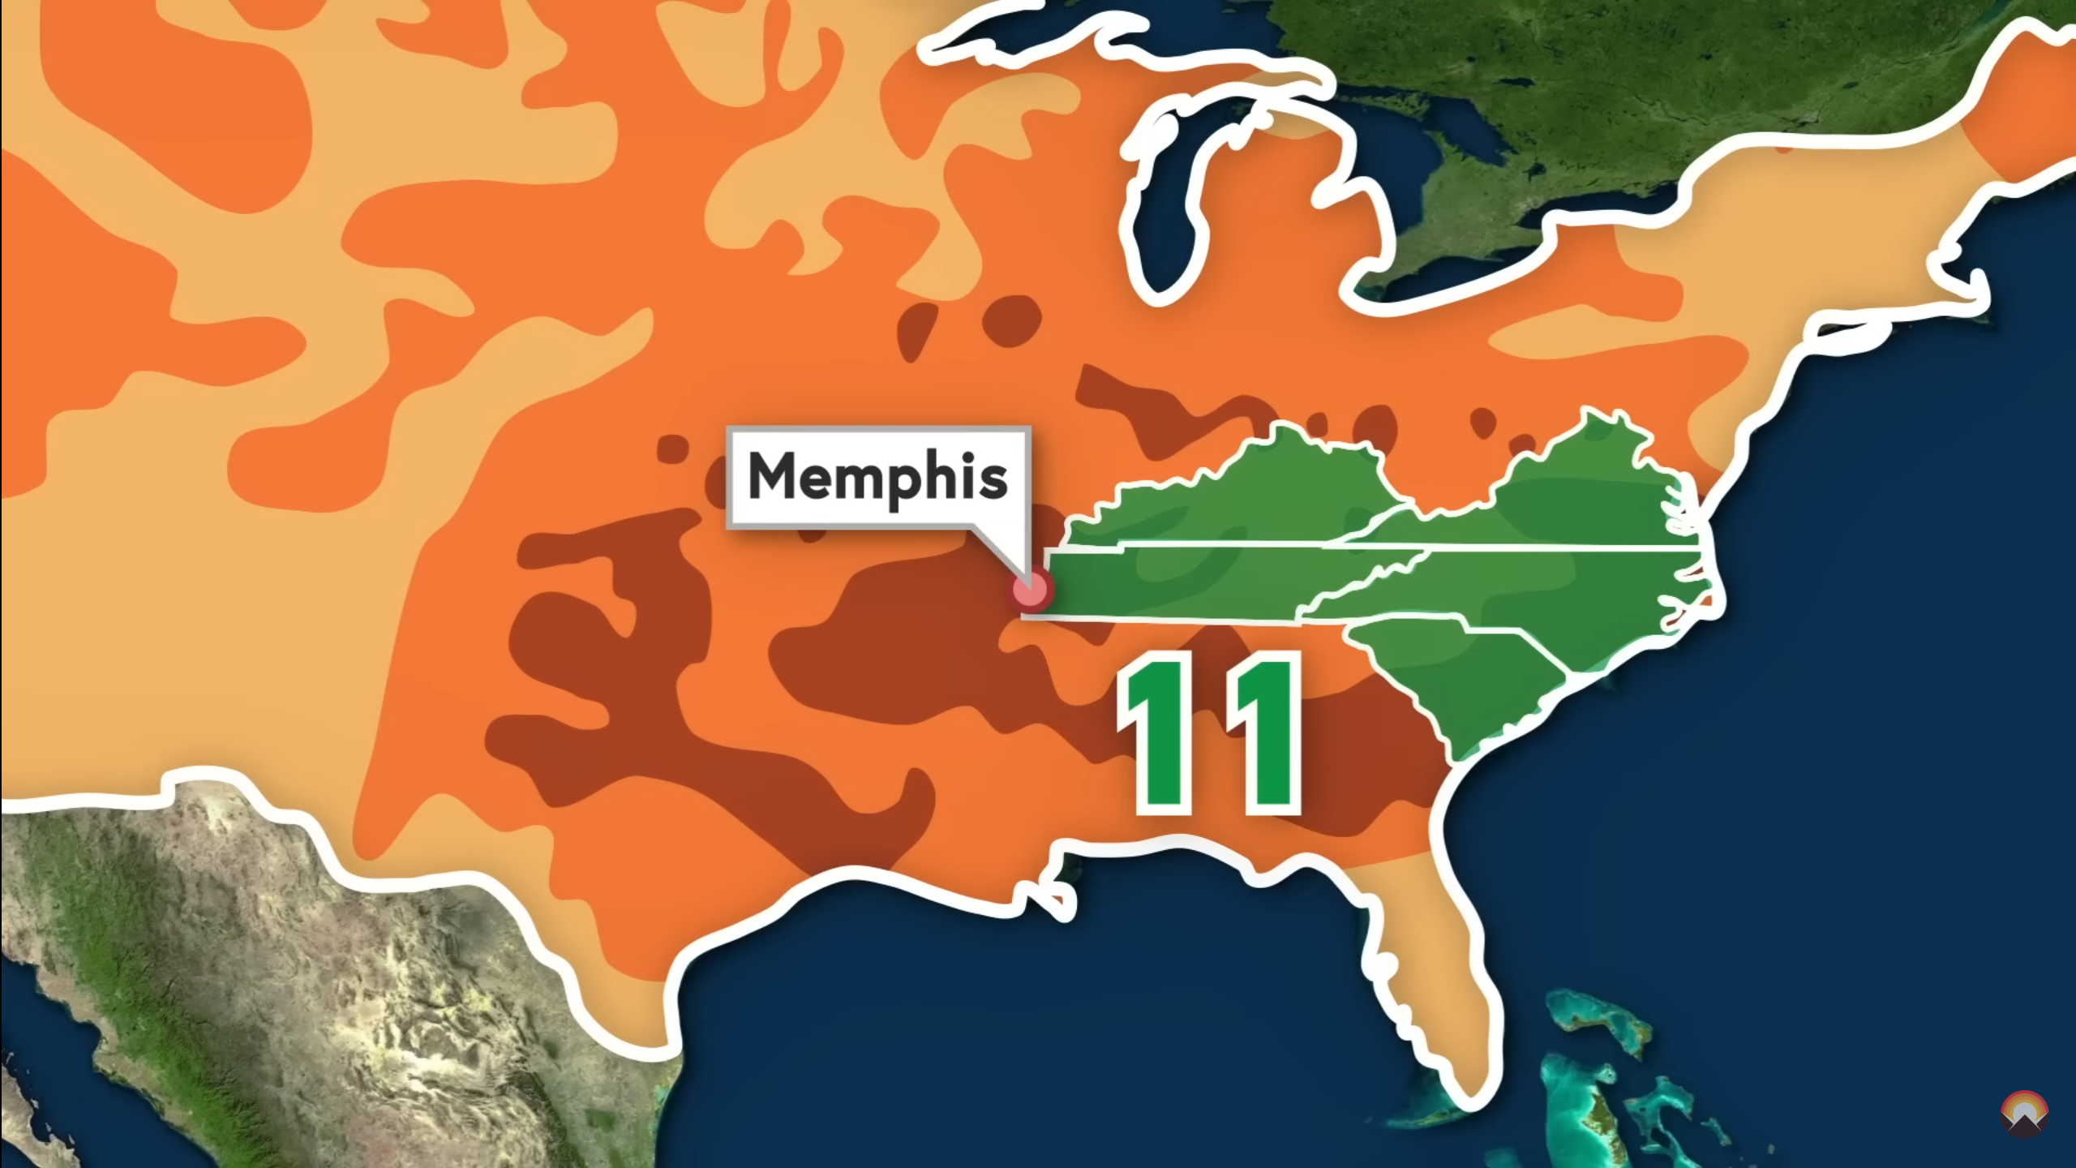
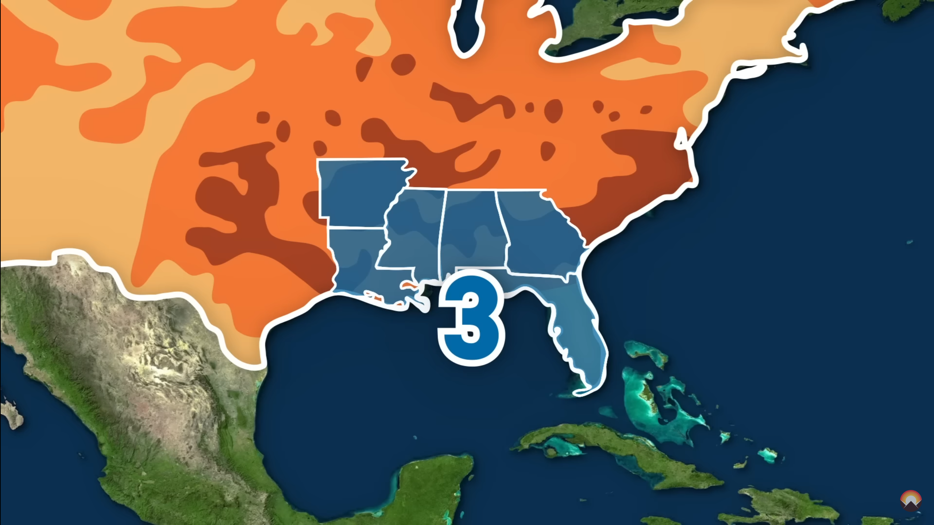
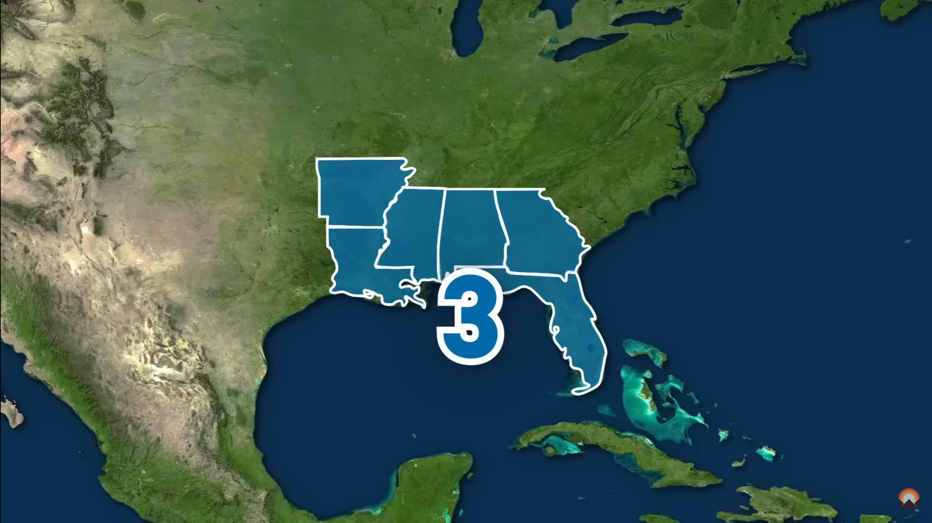


Organ Transplantation: An Example of Fairness Issues in Healthcare
Situations:
Limited supply of donated organs
Long waitlist for organ transplantation
Geographic Variation:
Region 3 donated 4,055 kidneys in 2019
Region 9 donated 1,564 In the same year
Demographic Disparities:
Increased gender disparity in Model For End
Stage Liver Disease (MELD)
Female: 46.5% vs. Male: 53.5%
Women’s creatinine level is lower
→ Longer Waiting time
Sacrifice of suitable sized organs for pediatric patients
Disparities in Post-Transplant Outcomes:
Varying graft failure rates across demographic groups
White: 42.34%, Black: 44.77%, Hispanic: 35.31%, Asian: 32.95%
The 11 geographic regions for allocating donor organs
Notes:
Acuity circles

Slide 11
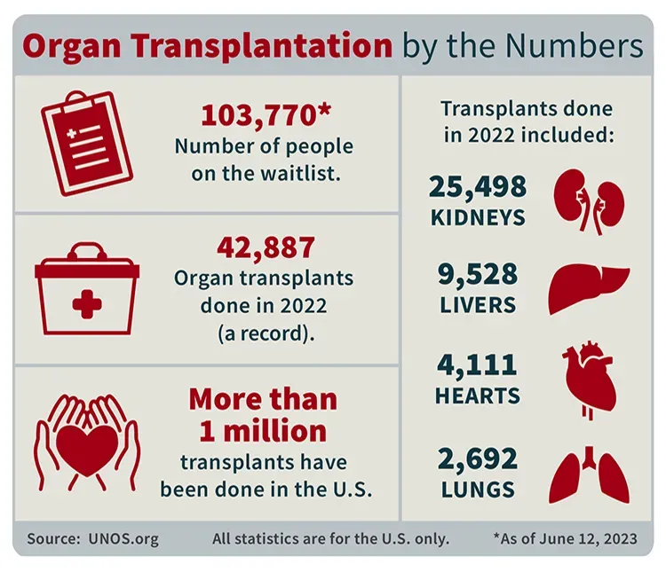
Organ Transplant Facts
More than 42,800 organ transplants performed in 2022
Total kidney transplants exceeded 25,000 for the first year ever
Annual records also set for liver, heart and lung transplants
Deceased donation continues 12-year record trend, 7.5% increase compared to 2021

Slide 12
Liver Transplant Background
Biliary tract complication
Acute liver failure
Hepatitis B/C
Thrombosis
Fatty liver
*Cirrhosis
*Chronic liver failure
Liver transplant
*Acute/chronic rejection
Graft failure
Genetic disease
Infection
Biliary disease
Primary liver cancer
Non function of donated liver
(*: Major cause)
Recurrent disease
Cause of liver transplant
Liver transplant
Cause of graft failure
Progression of liver transplant

Slide 13




Current Liver Allocation Policy
O | N | N | 2
O | Y | N | 3
A | Y | P | 5
O | Y | N | 5
O | Y | P | 5
37
37
36
36
MELD score calculation
35
Doctor
35
30
30
26
26
:Distance
Patients on waiting list
Patient ranking with MELD score
:Waiting time
Allocation decision
:Age
…
…
Other factors
An illustrative example of liver allocation process
*Note: In this work, the allocation policy we discussed and the data we used to analyze only represent the situations in the U.S.

Slide 14
MELD Score Calculation
Serum creatinine
Total bilirubin
MELD score
Originally developed for
Survival prediction
Adopted as objective score
Liver transplant prioritization
INR of prothrombin time
PELD score
MELD-Na score
Cirrhosis
Alcoholic hepatitis
Acute liver failure
Acute hepatitis
Lab tests
For child patient
MELD with serum Na
Liver diseases suitable for survival prediction
$$MELD score=9.57×\lg{creatinine}+3.78×\lg{total bilirubin}+11.2×\lg{INR}+6.43$$
MELD score calculation formulation
- MELD score measures risk of death within 90 days if not get an organ.

Slide 15
Bias in Liver Transplant
ORR: Organ Receiving Rate
GFR: Graft Failure Rate
Bias
Bias
Bias
Two statistical transplant metrics by gender
Two statistical transplant metrics by race
Observation: There exists bias in both organ receiving rate and graft failure rate across both genders and races.

Slide 16
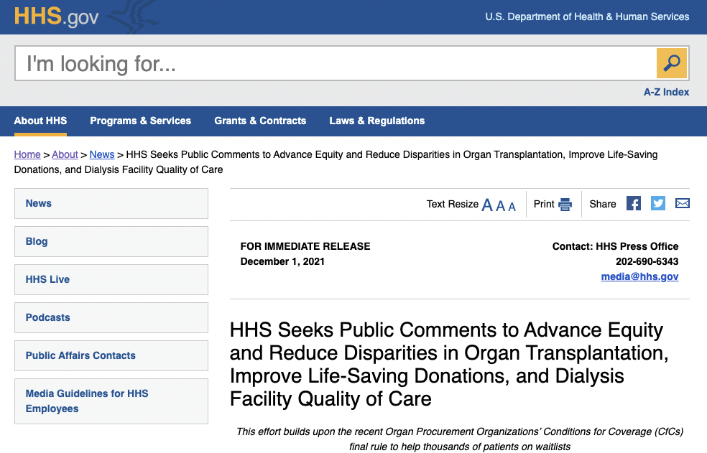
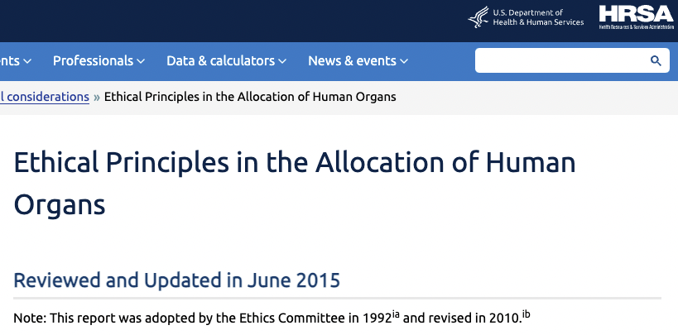
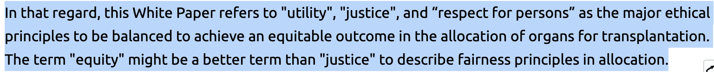
Fairness Principles in Organ Allocation
The fairness issue is essential in organ transplant scenario, gaining more and more attention. The equity has been set as the principles in practice.
Source: Media from HHS
Source: Whitepaper from HHS

Slide 17
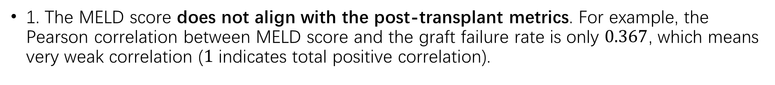
Drawback of MELD Score Strategy
1. The MELD score does not align with the post-transplant metrics. For example, the Pearson correlation between MELD score and the graft failure rate is only $0.367$, which means very weak correlation ($1$ indicates total positive correlation).
MELD score
Graft status
90 day risk of death ≠ graft failure rate
2. The MELD score does not explicitly consider the bias issue in its calculation. The bias may exist across different subgroups in the lab test results.

Slide 18
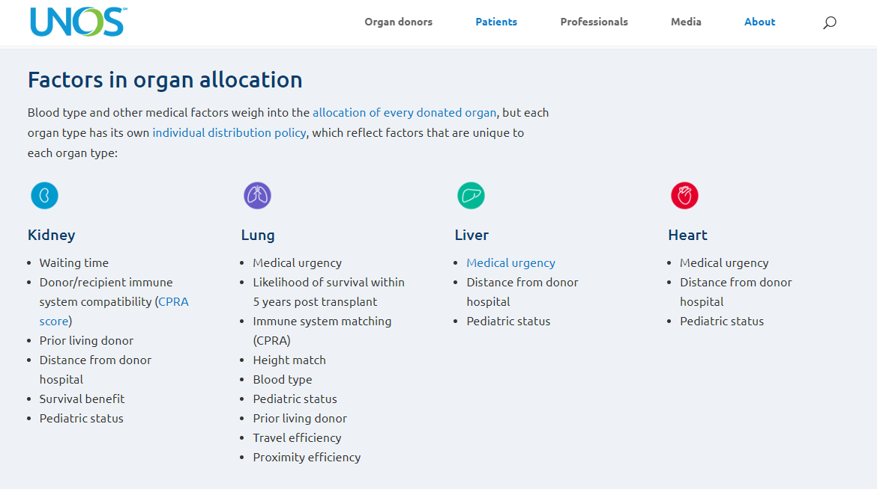
No prediction power on if patient donor are matching
Propose: A scoring system with: 1) known graft failure rate; 2) equity

Slide 19
A Two-step Debiasing Framework
Notes:
For the categorical features, we employ two kinds of encoders, including a one-hot encoder that maps the raw features to one-hot sparse vectors, and an integer encoder which transforms the categorical features into numerical values, where the latter are further concatenated with the original numerical features to serve as the final dense features.
In previous works, tree-based methods such as random forest [13] have been adopted for graft failure prediction. While tree-based methods often show strong performance on the dense features, they can hardly deal with the sparse features, especially when the feature cardinality is high, this is due to the curse of dimensionality [21]. And also, technically, it is quite difficult to incorporate fairness constraints into the tree-based methods. Because a large part of the fairness-achieving methods are in-processing methods, which usually means we need to modify the loss functions to incorporate fairness constraints. To tackle these challenges, we propose to combine deep learning and tree-based model for graft failure prediction.
The sparse features from the recipient and the organ are combined and processed by a categorical neural network (CatNN) [32, 33], which is an embedding lookup layer that maps categorical indices to dense vectors,
distilling the clustering patterns of the leaf nodes.

Slide 20
A Two-step Debiasing Framework
Debiasing step 1

Slide 21
A Two-step Debiasing Framework
Debiasing step 2

Slide 22
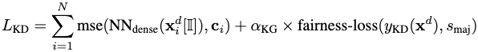
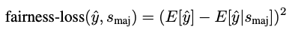
Knowledge Distillation for Fair Embedding
Tree model
Distilled knowledge
Neural network
Accurate but unfair
Accurate and fair
Fairness constraint
Knowledge distillation loss
Fairness loss in knowledge distillation

Slide 23
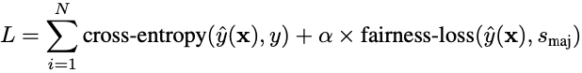
Fairness-aware Training
NN from sparse features
Fairness-aware training
Fair prediction
NN from dense features
Training loss
Fairness loss in training

Slide 24
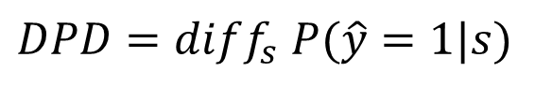
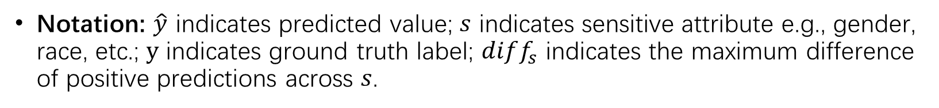
Fairness Metrics in Liver Transplant
Notation: $\hat{y}$ indicates predicted value; $s$ indicates sensitive attribute e.g., gender, race, etc.; $y$ indicates ground truth label; $diff_{s}$ indicates the maximum difference of positive predictions across $s$.
Demographic Parity Difference (DPD):
$$DPD=diff_{s} P(\hat{y}=1|s)$$
Equalized Odds Difference (EOD):
$$EOD=max⁡[diff_{s} P\left(\hat{y}=1 | s, y=1\right),diff_{s} P\left(\hat{y}=1 | s, y=0\right)]$$
DPD or EOD
,the severity of unfairness

Slide 25
Debiasing Graft Failure Prediction
Model | Race |  |  | Gender
 | AUC | DPD | EOD | AUC | DPD | EOD
LR | 0.777±0.000 | 0.648±0.017 | 0.834±0.007 | 0.777±0.000 | 0.021±0.000 | 0.033±0.001
RF | 0.804±0.000 | 0.630±0.030 | 0.703±0.047 | 0.804±0.000 | 0.020±0.001 | 0.036±0.001
GBDT | 0.809±0.000 | 0.637±0.027 | 0.713±0.033 | 0.809±0.000 | 0.017±0.000 | 0.031±0.001
Ours | 0.792±0.000 | 0.597±0.015 | 0.662±0.029 | 0.793±0.001 | 0.011±0.001 | 0.022±0.003
Prediction accuracy and bias of the proposed two-step debiasing method
Observation: Our framework can achieve competitive prediction accuracy with less bias across races and genders.

Slide 26
Effectiveness of Each Debiasing Step
Model | Race |  |  | Gender
 | AUC | DPD | EOD | AUC | DPD | EOD
w/o first step debias | 0.793±0.000 | 0.596±0.022 | 0.687±0.038 | 0.792±0.000 | 0.016±0.002 | 0.027±0.002
w/o second step debias | 0.793±0.001 | 0.616±0.041 | 0.745±0.076 | 0.793±0.001 | 0.014±0.007 | 0.026±0.009
Ours | 0.792±0.000 | 0.597±0.015 | 0.662±0.029 | 0.793±0.001 | 0.011±0.001 | 0.022±0.003
Ablation study of each step in the debiasing framework
Observation: Debiasing each part in the framework is necessary for fair prediction.

Slide 27
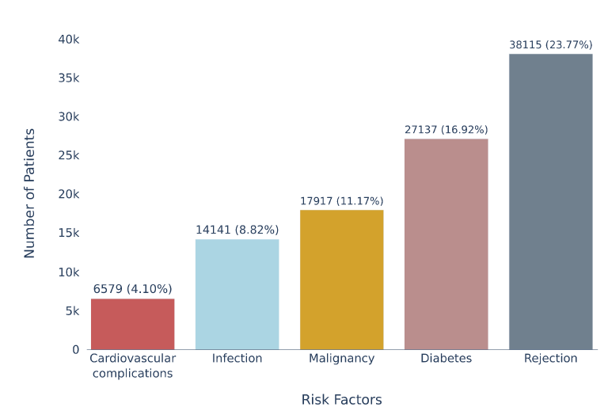
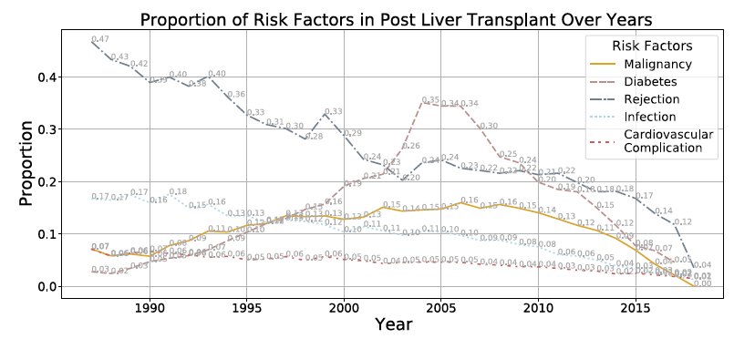
Post-transplant Risks
Previous studies: simple clinical scoring systems (MELD), or prediction models for individual risk prediction
Success of a liver transplant goes beyond patient survival, also depends on post-transplant risks
Such as: Cardiovascular disease; Rejection; Diabetes; Etc.
Post-transplant risk factors are highly interdependent*, indicating that a joint prediction approach would be more effective
* P.R. John, P.J. Thuluvath, Outcome of liver transplantation in patients with diabetes mellitus: a case-control study, Hepatology. 34 (2001) 889–895.

Slide 28
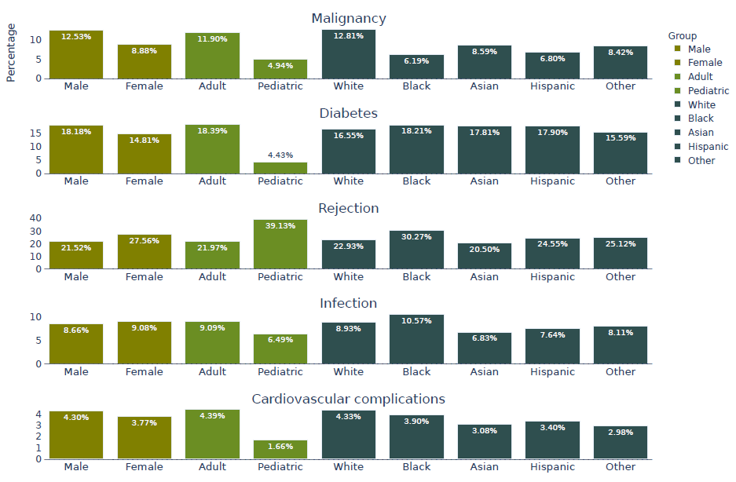
Post-transplant Risks

Slide 29
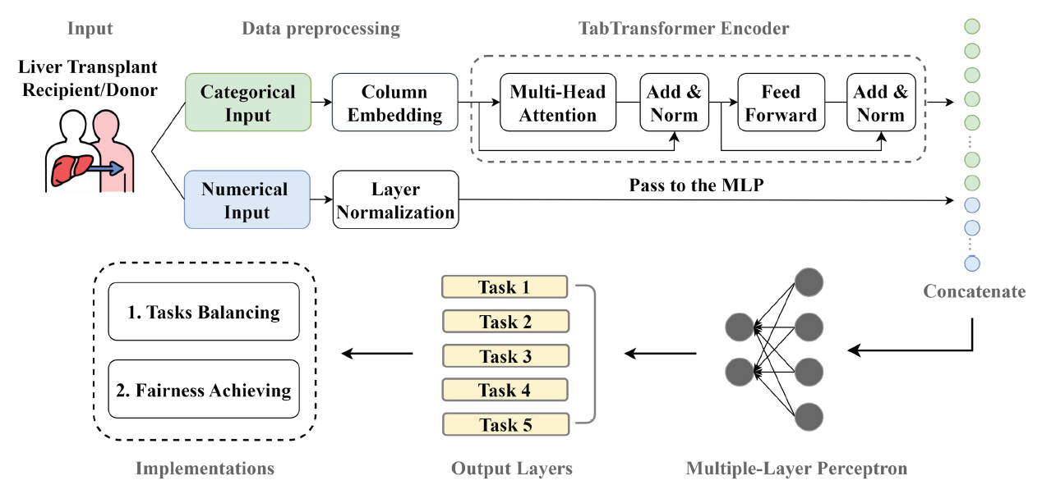
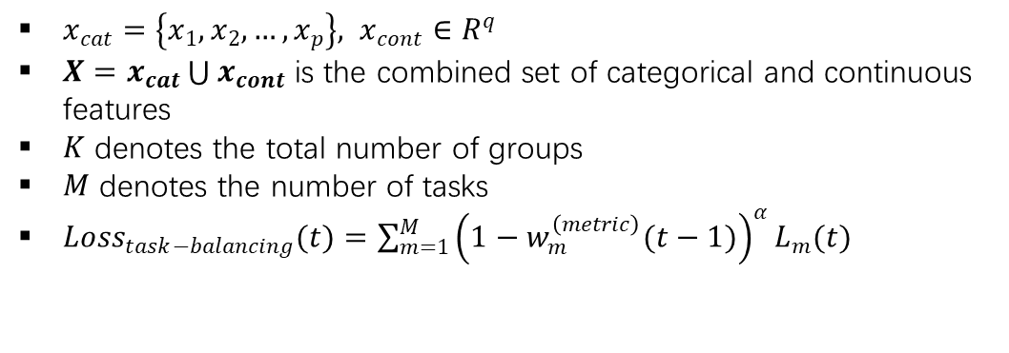
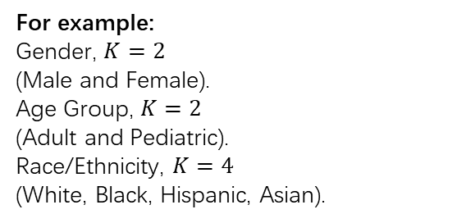
A Multitask-based Fairness Achieving Algorithm
$x_{cat}=\left\{x_{1}, x_{2},…,x_{p}\right\}, x_{cont}∈R^{q}$
$X=x_{cat}\bigcup{x_{cont}}$ is the combined set of categorical and continuous features
$K$ denotes the total number of groups
$M$ denotes the number of tasks
$Loss_{task−balancing}(t)=\sum_{m=1}^{M}{{\left(1−w_{m}^{\left(metric\right)}(t−1)\right)}^{α}L_{m}(t)}$
For example:
Gender, $K=2$
(Male and Female).
Age Group, $K=2$
(Adult and Pediatric).
Race/Ethnicity, $K=4$
(White, Black, Hispanic, Asian).
Tasks:
1: Malignancy
2. Diabetes
3. Rejection
4. Infection
5. Cardiovascular complications

Slide 30
Loss Progression Analysis: FERI vs. Baseline
FERI's performance across demographic groups during training (gender, age groups, race/ethnicity)
Observed training loss progression for each subgroup over successive epochs

Slide 31
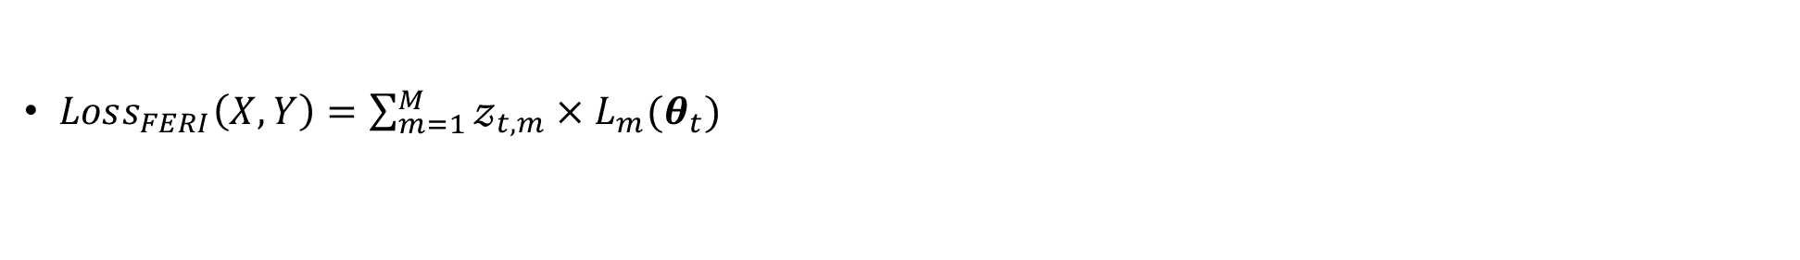
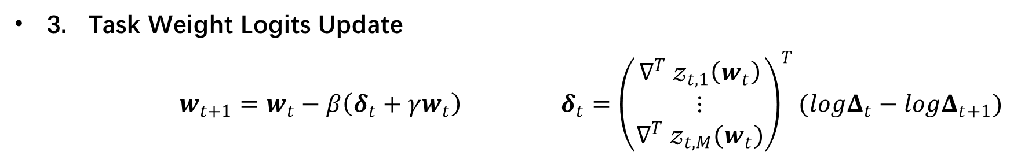
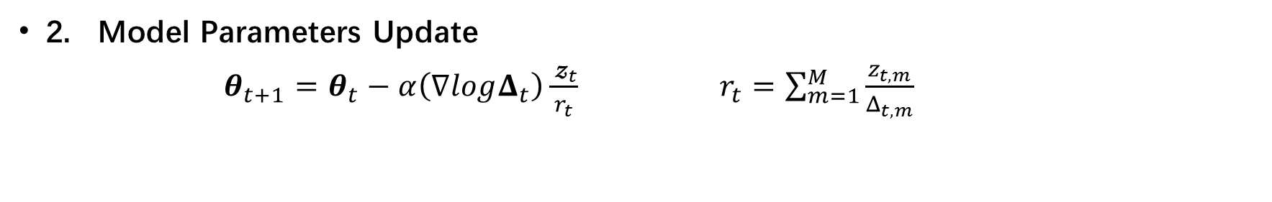
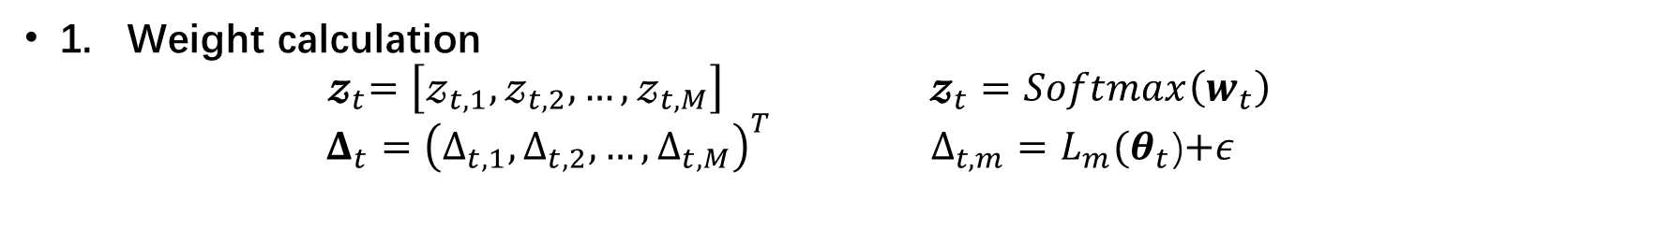
Fairness through the Equitable Rate of Improvement in Multitask Learning (FERI)
$Loss_{FERI}\left(X,Y\right)=\sum_{m=1}^{M}{𝓏_{t,m}×L_{m}(θ_{t})}$
1. Weight calculation
$${ 𝔃}_{t}=\left[𝓏_{t,1},𝓏_{t,2},…,𝓏_{t,M}\right] 𝔃_{t}=Softmax\left(w_{t}\right)$$
$$Δ_{t}={\left(Δ_{t,1},Δ_{t,2},…,Δ_{t,M}\right)}^{T} Δ_{t,m}=L_{m}(θ_{t}\text{)}\text{+}ε$$
2. Model Parameters Update
$θ_{t+1}=θ_{t}−α\left(∇logΔ_{t}\right)\frac{{ 𝔃}_{t}}{r_{t}} r_{t}=\sum_{m=1}^{M}{\frac{z_{t,m}}{Δ_{t,m}}}$
3. Task Weight Logits Update
$w_{t+1}=w_{t}−β\left(δ_{t}+γw_{t}\right)$ $δ_{t}={\left(\begin{matrix}∇^{T}{ 𝓏}_{t,1}\left(w_{t}\right) \\ ⋮ \\ ∇^{T}{ 𝓏}_{t,M}(w_{t})\end{matrix}\right)}^{T}(logΔ_{t}−logΔ_{t+1})$
Notes:
FERI adopt the idea of dynamically fine-tuning the subgroup learning rate and efficiently managing training speed to ensure demographic fairness.
The FERI algorithm consists of three main steps:
Weight calculation: For each task m at epoch t, the softmax function is applied to the logits to obtain the weight. An adjusted loss is computed for every task to understand the model’s current performance.
Model Parameters Update: The model parameters are updated based on the current epoch weights using weighted gradient descent, where the task weighting is re-normalized using a constant rt per epoch.
Task Weight Logits Update: Using the updated model parameters θ(t+1), task-specific losses are recomputed. The logits for each task, which guide the weight determination, are updated using the change in the logarithm of the loss function after the parameter update.
As training progresses, these logits (and consequently, the weights) will be adjusted to potentially give more importance to tasks that are harder or less importance to tasks that are easier, depending on task losses performance from the prior epoch.

Slide 32
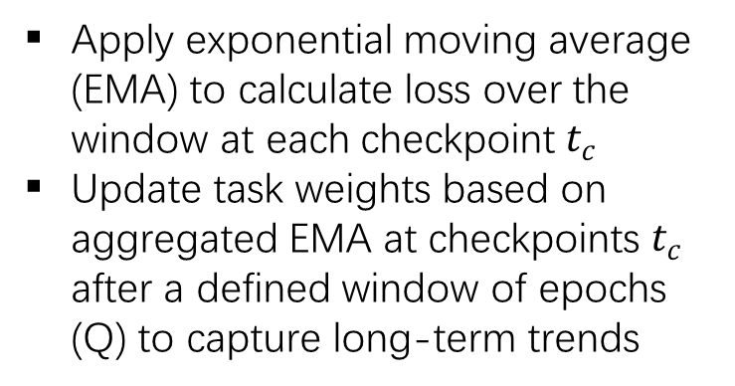
Proposed Approach:
Long-term Loss Trend Analysis
Apply exponential moving average (EMA) to calculate loss over the window at each checkpoint $t_{c}$
Update task weights based on aggregated EMA at checkpoints $t_{c}$ after a defined window of epochs (Q) to capture long-term trends

Slide 33
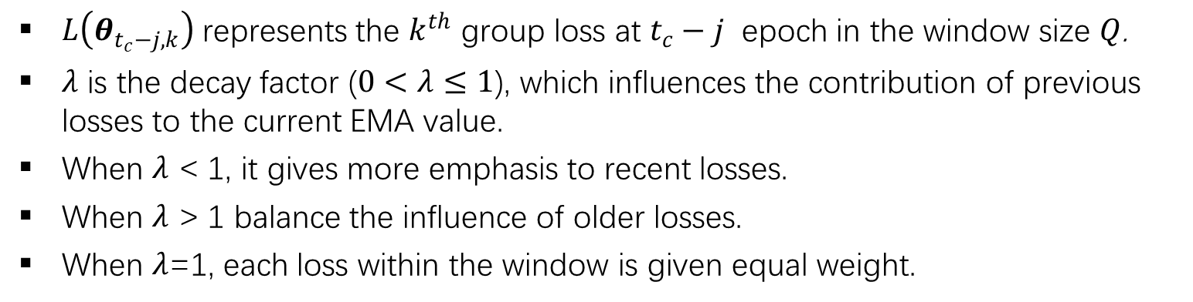
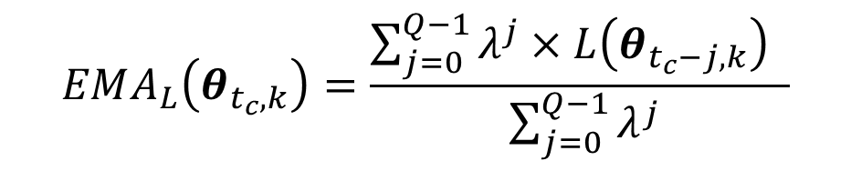
Exponential Moving Average (EMA) Loss (New)
$$EMA_{L}\left(θ_{t_{c},k}\right)=\frac{\sum_{j=0}^{Q−1}{λ^{j}×L\left(θ_{t_{c}−j,k}\right) }}{ \sum_{j=0}^{Q−1}{λ^{j}}}$$
$L\left(θ_{t_{c}−j,k}\right)$ represents the $k^{th}$ group loss at $t_{c}−j$ epoch in the window size $Q$.
$λ$ is the decay factor ($0<λ≤1$), which influences the contribution of previous losses to the current EMA value.
When $λ$ < 1, it gives more emphasis to recent losses.
When $λ$ > 1 balance the influence of older losses.
When $λ$=1, each loss within the window is given equal weight.

Slide 34
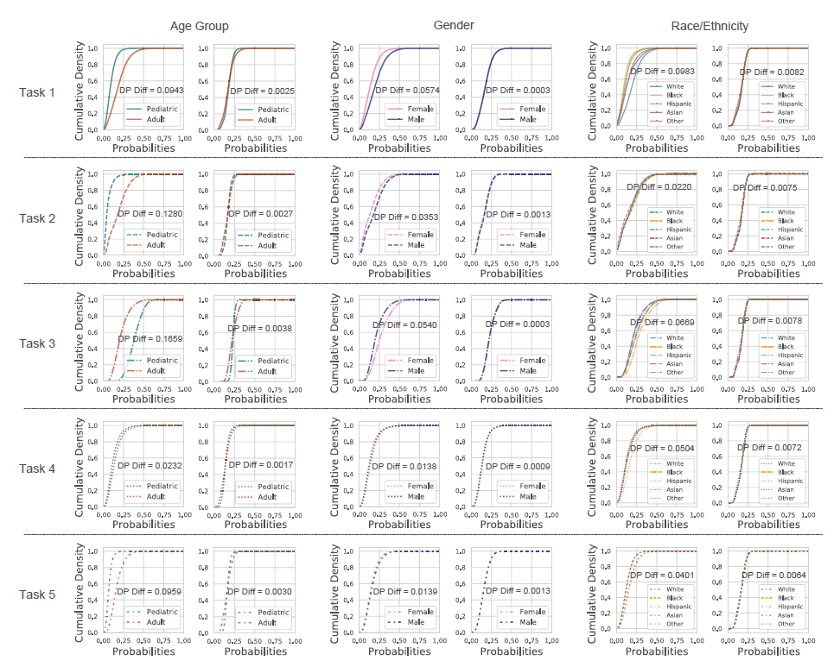
Comparison of Cumulative Density Functions (CDFs)

Slide 35
Accuracy Sacrifice Evaluation: FERI vs. Baseline
AUROC
AUPRC
Notes:
We use AUROC and AUPRC metrics to evaluate the accuracy of our FERI algorithm compared to the baseline model,
Remarkably, the FERI algorithm exhibited AUROC and AUPRC scores that closely align with those of the baseline model across all analyzed subgroups. The notation Δ in the figures represents the absolute difference between the FERI and baseline values, highlighting a minimal trade-off.
Specifically, the AUROC values for both models consistently exceeded the 0.7 threshold, and AUPRC values were above 0.6. These results provide robust evidence that our FERI algorithm succeeded in improving fairness metrics without sacrificing predictive accuracy.
(to summarize the results)
Through these experiments, FERI consistently outperformed the baseline models, demonstrating its effectiveness in balancing both predictive accuracy and fairness in predicting liver transplant graft failure across all sensitive attributes. This highlights the potential of our proposed algorithm in addressing fairness concerns while maintaining high predictive performance in critical clinical applications

Slide 36
Discussion
FERI: better algorithm to “synchronize” the loss curves
AI Fairness on medical imaging
Extend to other settings:
Fair survival model for organ transplant
Fair federated learning model for organ transplant

Slide 37
Thank you

Slide 38
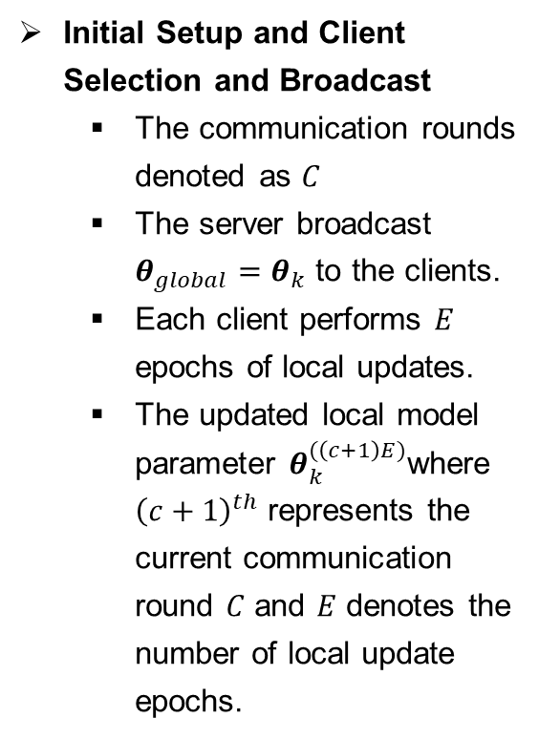
Future Works
Initial Setup and Client Selection and Broadcast
The communication rounds denoted as $C$
The server broadcast $θ_{global}=θ_{k}$ to the clients.
Each client performs $E$ epochs of local updates.
The updated local model parameter $θ_{k}^{(\left(c+1\right)E)}$where ${\left(c+1\right)}^{th}$ represents the current communication round $C$ and $E$ denotes the number of local update epochs.
2/10
Notes:
Overall, this dynamic task weighting approach in multi-task setting continually adjusts the importance of each subgroup task during training. As training progresses, the task weights are tuned to potentially increase emphasis on harder tasks or reduce emphasis on easier ones. In this way, the model shifts attention between tasks depending on their optimization progress. By utilizing loss trends over a window of checkpoints rather than a single step, we can capture more consistent representations of the decreasing loss trajectories for each subgroup. In the future work, will explore more advanced loss trajectory modeling techniques and also considering to achieve fairness between the demographic subgroup interactions such as female white patients, female black patients.

Slide 39
Demographic Statistics of Liver Transplant
Demographic statistics by gender
Demographic statistics by race
Observation: There exist difference in population size and average MELD score across both genders and races.

Slide 40


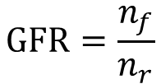
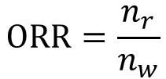
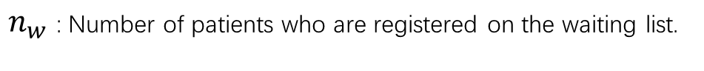
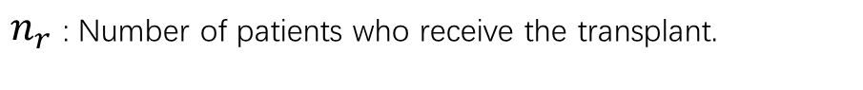
Statistical Metrics in Liver Transplant
Define two statistical metrics for liver transplant as follows:
ORR: Organ Receiving Rate
GFR: Graft Failure Rate
$$ORR=\frac{n_{r}}{n_{w}}$$
$$GFR=\frac{n_{f}}{n_{r}}$$
$n_{r}$: Number of patients who receive the transplant.
$n_{f}$:Number of patients suffer from graft failure.
$n_{w}$: Number of patients who are registered on the waiting list.
$n_{r}$:Number of patients who receive the transplant.
ORR
,chance of receiving a liver
GFR
,chance of graft failure

Slide 41
Machine Learning (ML) for Liver Transplant
Post-transplant survival rate
Patient/donor features
ML model
Chance of rejection
Doctor
Allocation decision
Graft failure
……
Various medical criterions
ML assisted allocation process
Advantages of ML method compared to MELD-score based method:
Supporting various medical criterions, like survival rate, post transplant rejection, etc.
Higher prediction accuracy with ML model.
Flexible with tuning hyper-parameters, which can be adapted with different data distribution.

Slide 42
Bias of ML in Liver Transplant
Model | Race |  |  | Gender
 | AUC | DPD | EOD | AUC | DPD | EOD
Logistic Regression (LR) | 0.777±0.000 | 0.648±0.017 | 0.834±0.007 | 0.777±0.000 | 0.021±0.000 | 0.033±0.001
Random Forest (RF) | 0.804±0.000 | 0.630±0.030 | 0.703±0.047 | 0.804±0.000 | 0.020±0.001 | 0.036±0.001
Gradient Boosting Decision Tree (GBDT) | 0.809±0.000 | 0.637±0.027 | 0.713±0.033 | 0.809±0.000 | 0.017±0.000 | 0.031±0.001
Prediction accuracy and bias of baselines on graft failure
Observation 1: ML is a promising way to predict transplant-related criteria, e.g., graft failure, which can help more precise transplant decisions.
Observation 2: The bias of ML in transplant is very high, especially in the context of different races, which hinders the direct application in transplant scenarios.

Slide 43
Challenges of Applying ML
Bias exists in the raw data, which may cause the data-driven model to be biased. However, it is challenging to debias the input data.
Incorporate the fairness goal in the pipeline and make a trade-off between fairness and accuracy remains as a challenge.
Challenge 1
Challenge 2
Biased inputs
Prediction model
Biased outputs
Model A
Model B
Accurate but unfair
Inaccurate but fair
Data-driven model also learn the bias from data.
How to be both accurate and fair?

Slide 44
Preliminary Results: FERI Algorithm for Fair Predictions in Liver Transplantation
Previous Work (Li, C., Lai, D., Jiang, X., & Zhang, K. (2023))
Introduced Fairness through Equitable Rate of Improvement in Multitask Learning (FERI) algorithm
Applied FERI to fair predictions of graft failure risk in liver transplant patients using a multitask transformer-based model
FERI Approach
Constrained subgroup loss by balancing learning rates and preventing subgroup dominance at each training step (epoch)
Results
Maintained high predictive accuracy (AUROC and AUPRC) comparable to baseline models
Reduced demographic parity disparity in gender by 71.74%
Decreased equalized odds disparity in age group predictions by 40.46%
4/11
Notes:
For the preliminary results, we have introduced the Fairness through Equitable Rate of Improvement in Multi-Task Learning (FERI) algorithm, applied to fair prediction of graft failure risk in liver transplant patients. FERI constrains subgroup loss by balancing learning rates and preventing subgroup dominance at each training epoch.
The results demonstrate FERI's effectiveness:
It maintained high predictive accuracy (AUROC and AUPRC) comparable to baseline models. Meanwhile, FERI reduced demographic parity disparity in gender predictions by 71.74% and decreased equalized odds disparity in age group predictions by 40.46%.

Slide 45
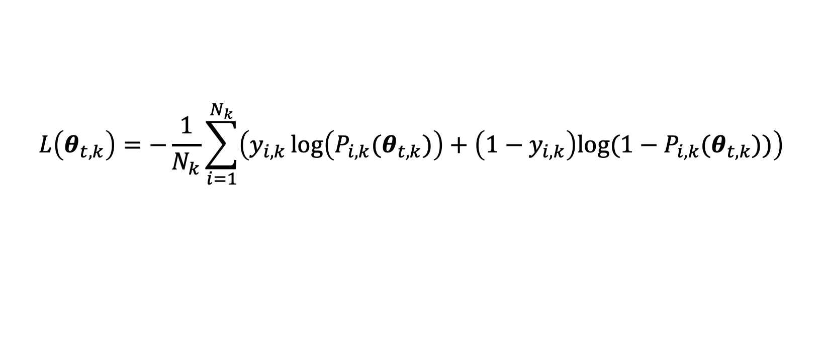
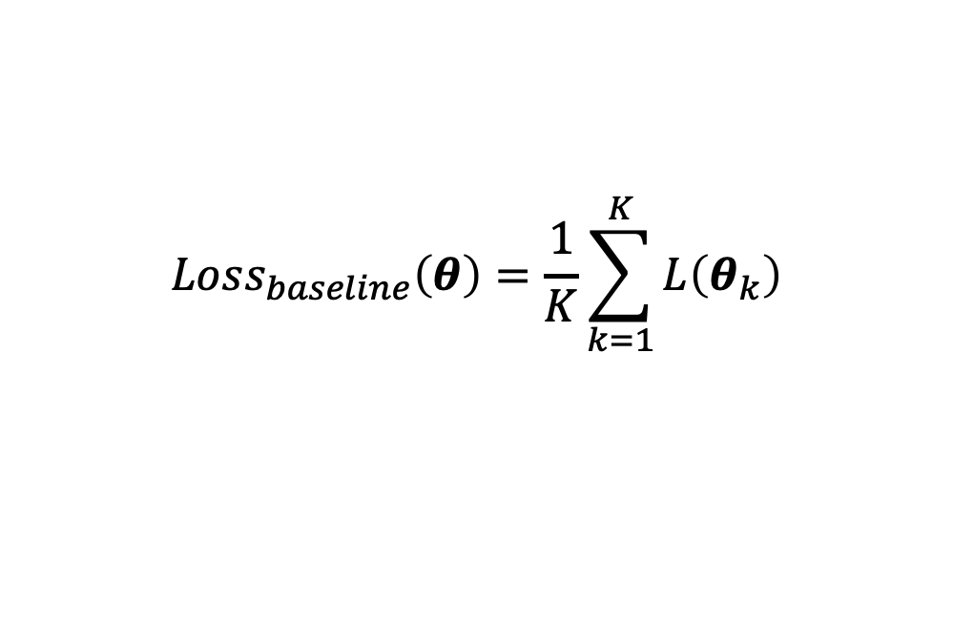
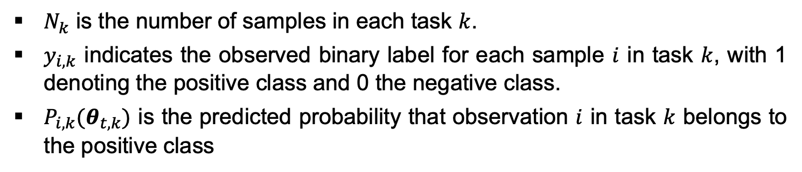
Binary Cross-entropy Loss (BCE)
$$L\left(θ_{t,k}\right)=−\frac{1}{N_{k}}\sum_{i=1}^{N_{k}}{\left(y_{i,k}\log\left(P_{i,k}(θ_{t,k})\right)+\left(1−y_{i,k}\right)log⁡(1−P_{i,k}(θ_{t,k}))\right)}$$
$$Loss_{baseline}\left(θ\right)=\frac{1}{K}\sum_{k=1}^{K}{L\left(θ_{k}\right)}$$
Baseline Model
$N_{k}$ is the number of samples in each task $k$.
$y_{i,k}$ indicates the observed binary label for each sample $i$ in task $k$, with 1 denoting the positive class and 0 the negative class.
$P_{i,k}(θ_{t,k})$ is the predicted probability that observation $i$ in task $k$ belongs to the positive class
3/11
Notes:
The binary cross-entropy (BCE) loss function is used for this binary classification problem.
As a baseline, we employed a model that uses an average of the loss from each task for optimization.

Slide 46
Methodology
Overview: In-processing algorithm to achieve group fairness in each sensitive attribute (gender, age group, and race/ethnicity)
Goal: Develop fair machine learning algorithms for healthcare prediction both accurate and equitable.
Approaches:
Utilized Multitask Learning (MTL) to balance subgroups’ training process
MTL aligns with the need for equity by concurrently learning tasks for different demographic subgroups
Distribute model capacity evenly and address training disparities to mitigate biases
Constrain subgroup loss functions to prevent disproportionate impact on learning
Long-term loss trend analysis to dynamically adjust subgroup weights, ensuring consistent training and mitigating systemic biases.
1/11
Notes:
Let's begin by discussing the methodology for achieving group fairness across sensitive attributes like gender, age, and race/ethnicity.
The goal in this aim is to develop a in processing algorithms for healthcare predictive modeling that are both accurate and equitable.
The methodology employs Multitask Learning (MTL), a framework well-suited for promoting equity as it concurrently learns tasks associated with different demographic subgroups. The underlying rationale is that MTL can inherently mitigate training disparities that often arise between subgroups, leading to biased models.
The MTL framework mitigates training speed disparities by evenly distributing model capacity across subgroups, enabling fair, unbiased predictions. Both fairness and MTL aim to address the core issue of disproportionate training rates
To achieve this, constrain the loss functions to prevent any one subgroup from disproportionately impacting the overall learning process.
Additionally, the approach will use a long-term trend analysis to adjusts weights for subgroups to maintain consistent training and address systemic biases in various patient demographics.
Ultimately, the integration of fairness into the MTL framework promotes balanced attention and bias mitigation among subgroups.

Slide 47
Disparity Analysis: FERI vs. Baseline
Sensitive Attributes | Baseline | FERI | Baseline | FERI
 | Demographic Parity |  | Equalized Odds
Gender | 0.0046 (±0.0037) | 0.0013 (±0.0017) | 0.0245 (±0.0069) | 0.0165 (±0.0079)
Age Group | 0.0777 (±0.0084) | 0.0526 (±0.0127) | 0.0833 (±0.0128) | 0.0496 (±0.0211)
Race/Ethnicity | 0.1156 (±0.0081) | 0.1028 (±0.0107) | 0.1910 (±0.0157) | 0.1714 (±0.0219)
Notes:
This table presents the disparity analysis results, comparing the demographic parity and equalized odds metrics between the baseline and FERI models across sensitive attributes of gender, age group, and race/ethnicity. Lower values indicate a greater potential for achieving fairness.
Across all attributes, the FERI algorithm consistently outperformed the baseline, indicating reduced unfairness. For the gender attribute, FERI achieved a demographic parity disparity of 0.0013 (±0.0017) compared to the baseline's 0.0046 (±0.0037).
FERI also displayed improvements for age group, race and ethnicity, underscoring its efficacy in promoting fairness across all sensitive attributes.

Slide 48
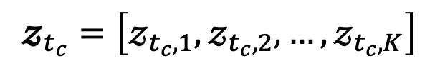
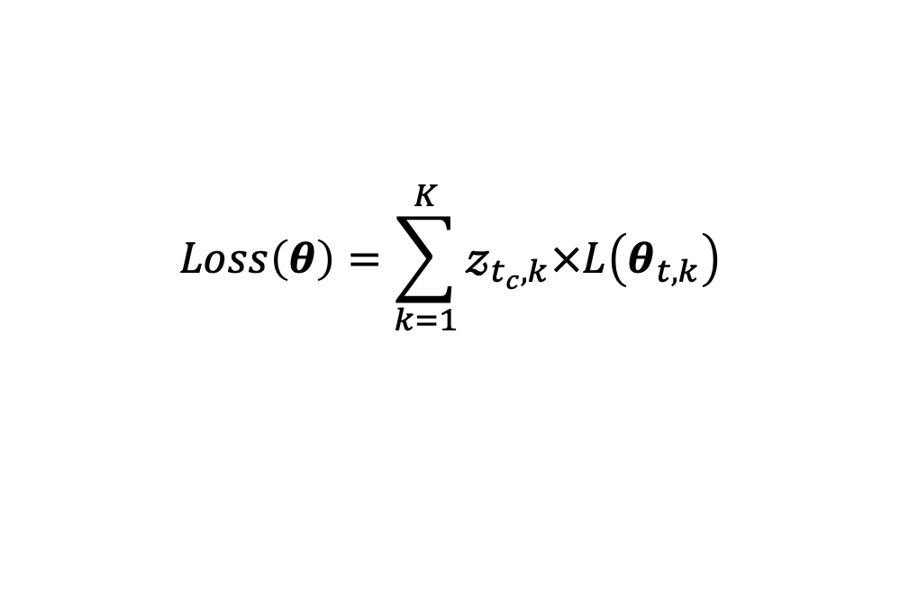
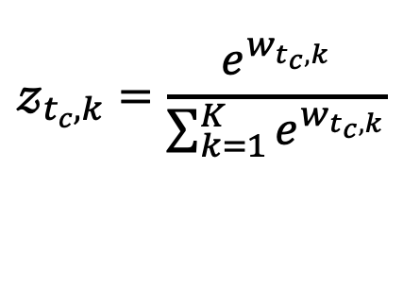
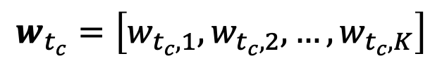
Dynamically Adjusting Loss Function Weights
$$Loss\left(θ\right)=\sum_{k=1}^{K}{𝓏_{t_{c},k}×L\left(θ_{t,k}\right)}$$
1. Group Weight Calculation
$$𝓏_{t_{c},k}=\frac{e^{w_{t_{c},k}}}{\sum_{k=1}^{K}{e^{w_{t_{c},k}}}}$$
$$w_{t_{c}}=\left[w_{t_{c},1},w_{t_{c},2},…,w_{t_{c},K}\right]$$
$$𝔃_{t_{c}}=\left[𝓏_{t_{c},1},𝓏_{t_{c},2},…,𝓏_{t_{c},K}\right]$$
Group Logits
Softmax Function (Goodfellow, I., Bengio, Y., & Courville, A. (2016))
Group Weights
Notes:
after talking about how to learn the predefined window size losses in EMA manner. Let me talk about how the EMA losses calculated on each checkpoint will influcence the task weight adjustment.
The approach adopt the idea of dynamically fine-tuning the subgroup loss function weights and efficiently managing training speed to ensure demographic fairness in each window size. It introduces a weighting scheme into the likelihood maximization process, which adaptively prioritize the learning of different tasks based on their current performance.
It consists of three main steps:
Task Weight calculation: the W_tc indicate the task logit for each subgroup. Then, the softmax function is applied to the logits to obtain the weight.

Slide 49
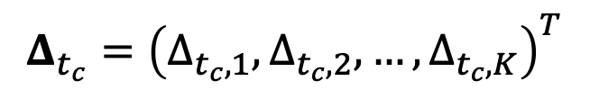



Dynamically Adjusting Loss Function Weights
$$Loss\left(θ\right)=\sum_{k=1}^{K}{𝓏_{t_{c},k}×L\left(θ_{t,k}\right)}$$
2. Checkpoint EMA Loss Update
(Liu, B., Feng, Y., Stone, P., & Liu, Q. (2023); Li, C., Lai, D., Jiang, X., & Zhang, K. (2023))
$$∆_{t_{c},k}=EMA_{L}\left(θ_{t_{c},k}\right)+ε$$
$$Δ_{t_{c}}={\left(Δ_{t_{c},1},Δ_{t_{c},2},…,Δ_{t_{c},K}\right)}^{T}$$
Group-specific Loss
$$∆_{t_{c}+Q,k}=EMA_{L}\left(θ_{t_{c}+Q,k}\right)+ε$$
$$Δ_{t_{c}+Q}={\left(Δ_{t_{c}+Q,1},Δ_{t_{c}+Q,2},…,Δ_{t_{c}+Q,K}\right)}^{T}$$
New Group-specific Loss
Notes:
The next step is Model Parameters Update:
A task specific loss is computed for each task to understand the model’s current checkpoint performance.
After the modeling running after the next window size epochs, it reaches to the next checkpoint.
The new adjusted task-specific loss is recomputed for each task. It is crucial as it provides the necessary information to adjust the importance weights or logits of the task in each checkpoint.

Slide 50



Dynamically Adjusting Loss Function Weights
$$Loss\left(θ\right)=\sum_{k=1}^{K}{𝓏_{t_{c},k}×L\left(θ_{t,k}\right)}$$
3. Group Weight Logits Update
(Liu, B., Feng, Y., Stone, P., & Liu, Q. (2023); Li, C., Lai, D., Jiang, X., & Zhang, K. (2023))
$$w_{t_{c}+Q}=w_{t_{c}}−\left(δ_{t_{c}}+γw_{t_{c}}\right)$$
Group Logits
$$δ_{t_{c}}={\left(\begin{matrix}∇^{T}𝓏_{t_{c},1}\left(w_{t_{c}}\right) \\ ⋮ \\ ∇^{T}𝓏_{t_{c},k}\left(w_{t_{c}}\right)\end{matrix}\right)}^{T}\left(logΔ_{t_{c}}−logΔ_{t_{c}+Q}\right)$$
$$z_{t_{c}+Q,k}=\frac{e^{w_{t_{c+Q},k}}}{\sum_{k=1}^{K}{e^{w_{t_{c}+Q,k}}}}$$
New Group Weights
Notes:
The third step is the Task Weight Logits Update.
The logits for each task, which guide the determination of task weights, are updated based on the difference between the log of the previous checkpoint loss (which accumulates all losses in the previous window) and the log of the current checkpoint loss (which accumulates all losses in the current window).
Delta is it's a measure of how the weight should be adjusted according to the changes in the performance metric over time. This product will give you the direction and magnitude by which to adjust the weights in order to account for the change in performance metrics.
As training progresses, these logits and consequently, the weights from softmax function again will be adjusted to potentially give more importance to tasks that are harder or less importance to tasks that are easier, depending on task losses performance from the prior window size.
####
This gradient will tell you how changes in the weight would have affected this difference in performance.
if the gradient is positive, it means that increasing the weight will increase the loss function (worsening performance).
If the gradient is negative, it means that increasing the weight will decrease the loss function (improving performance).
The term γwtc​​ appears to be a regularization term that also works to constrain the magnitude of the weights.
###

Slide 51



Algorithmic Fairness-Enhancing Mechanisms
Definition of Algorithmic Fairness
The process of ensuring that algorithms and their outcomes are unbiased and that they don’t discriminate against individuals or groups based on sensitive attributes like race, gender, or age.
Sources of bias determine the approaches to achieving fairness
Pre-processing algorithms mitigate biases in input data before modeling
In-processing algorithms balance model accuracy and fairness during the training process
Post-processing algorithms align output within fairness criteria after modeling

